Slide 1




The DRAM Latency PUF: Quickly Evaluating Physical Unclonable Functions by Exploiting the Latency-Reliability Tradeoff in Modern Commodity DRAM Devices
Jeremie S. Kim Minesh Patel
Hasan Hassan Onur Mutlu
Notes:
20 Minute talk 5 minute questions
Hello, my name is Jeremie Kim and I will be presenting the DRAM Latency PUF, a mechanism to quickly evaluate physical unclonable functions by exploiting the latency-reliability tradeoff in modern commodity DRAM devices.

Slide 2
Executive Summary
Motivation:
We can authenticate a system via unique signatures if we can evaluate a Physical Unclonable Function (PUF) on it
Signatures (PUF response) reflect inherent properties of a device
DRAM is a promising substrate for PUFs because it is widely used
Problem: Current DRAM PUFs are 1) very slow, 2) require a DRAM reboot, or 3) require additional custom hardware
Goal: To develop a novel and effective PUF for existing commodity DRAM devices with low-latency evaluation time and low system interference across all operating temperatures
DRAM Latency PUF: Reduce DRAM access latency below reliable values and exploit the resulting error patterns as unique identifiers
Evaluation:
Experimentally characterize 223 real LPDDR4 DRAM devices
2. DRAM latency PUF (88.2 ms) achieves a speedup of 102x/860x at 70°C/55°C over prior DRAM PUF evaluation mechanisms
Notes:
To begin, I will give a brief overview. [CLICK] Our motivation is that we can [CLICK] authenticate a system via unique signatures if we can evaluate a Physical Unclonable Function (PUF) on it. [CLICK] These signatures or PUF responses reflect inherent properties of a device making it unique to the DRAM device generating it. [CLICK] DRAM memory technology is widely used today and has significantly many units that can be used in PUF evaluation, which makes it a promising substrate to evaluate PUFs on. A DRAM PUF would enable you to authenticate any system with a DRAM device on it. [CLICK] The main problem is that current DRAM PUFs are either slow, taking on the order of minutes to evaluate, require a DRAM reboot, or require additional custom hardware and cannot be used on commodity DRAM devices. [CLICK] To this end the goal of this work is to develop a novel and effective PUF for commodity DRAM devices that can be evaluated with low latency and low system interference across all operating temperatures. [CLICK] Our key idea is to reduce DRAM read access latency below the reliable datasheet specifications using software-only system calls in order to exploit the resulting error patterns as unique identifiers. We can do this because we observe that we get reliable and consistent error patterns as a result that can be used as a PUF responses [CLICK] We experimentally characterize 223 real LPDDR4 DRAM devices, and show that DRAM latency PUFs satisfy the requirements of an effective PUF [CLICK] We also find that the DRAM latency PUF can be evaluated in 88.2 ms on average regardless of temperature. Since the evaluation time of prior DRAM PUFs depends on temperature, there is a large tradeoff space. However, we determine that we still achieve a speedup orders of magnitude larger than the prior DRAM PUF proposals at common operating temperatures.

Slide 3
The DRAM Latency PUF Outline
Motivation
Effective PUF Characteristics
DRAM Latency PUF
DRAM Operation
Key Idea
Prior Best DRAM PUF: DRAM Retention PUF
DRAM Cell Retention
Key Idea
Weaknesses
Methodology
Results
Summary
Notes:
Here is the outline for the talk today

Slide 4
The DRAM Latency PUF Outline
Motivation
Effective PUF Characteristics
DRAM Latency PUF
DRAM Operation
Key Idea
Prior Best DRAM PUF: DRAM Retention PUF
DRAM Cell Retention
Key Idea
Weaknesses
Methodology
Results
Summary
Notes:
I will first expand upon the motivation of our work

Slide 5
Motivation
We want a way to ensure that a system’s components are not compromised
Physical Unclonable Function (PUF): a function we evaluate on a device to generate a signature unique to the device
We refer to the unique signature as a PUF response
Often used in a Challenge-Response Protocol (CRP)
Input:
Challenge_{X}
Trusted Device
Device
Authenticated
✔
Checking
PUF response
Evaluating
PUF
.
.
Output:
PUF Response_{X}
.
.
.
.
TODO: nice PUF input/output animation showing how a CRP works. Define evaluate, define input, and output (PUF response)
Notes:
[CLICK] We want a way to ensure that a system’s components are not compromised. One example would be if an attacker maliciously swaps a healthy component with a faulty one at runtime in order to steal information. [CLICK] A method for detecting this change in the system would be the use of a physical unclonable function or a PUF. A PUF is a function that we evaluate on a device to generate a signature that is unique to a device. [CLICK] We refer to this unique signature as a PUF response and it reflects the properties inherent In the device, making it unique to the device that generated it. [CLICK] PUFs are often used in a challenge-response protocol (CRP) for device authentication, which works as follows: [CLICK] a trusted device issues an [CLICK] input or a challenge X to the device [CLICK] The device then evaluates the physical unclonable function with the given challenge X, and [CLICK] returns the PUF response X to the trusted device. [CLICK] The trusted server then checks the PUF response, and if it matches the expected response for the given input challenge X, the device will be authenticated and can now be trusted to perform privileged tasks. [CLICK]
====================
[CLICK] A PUF is a function that generates a signature that is unique to a given device. [CLICK] PUFs are often used in a challenge response protocol, which we refer to as a CRP, for authentication. [CLICK] A trusted server, which stores a database of challenges and expected PUF responses, issues a challenge to a device in the form of inputs, or conditions in which the PUF response must be generated. If the device returns the correct PUF response, then the device is authenticated. [CLICK] We need a reliable and fast PUF for systems that use RDMA or perform functions on remote devices or [CLICK] systems with interchangeable system components such as SSD drives

Slide 6
Motivation
We want a runtime-accessible PUF
Should be evaluated quickly with minimal impact on concurrent applications
Can protect against attacks that swap system components with malicious parts
2. DRAM is a promising substrate for evaluating PUFs because it is ubiquitous in modern systems
Unfortunately, current DRAM PUFs are slow and get exponentially slower at lower temperatures
Notes:
[CLICK] First, we want a PUF that is runtime-accessible, which means that the PUF can be evaluated quickly with minimal performance impact on concurrently running applications. [CLICK] The faster you can evaluate a PUF, the earlier you can detect whether a system component has been compromised, and the better you can protect against a wide array of attacks. [CLICK] Secondly, we want to provide a runtime-accessible PUF that can be evaluated on DRAM since it is a ubiquitous memory technology in modern systems today. [CLICK] The problem with current DRAM PUFs, is that they are slow and get exponentially slower at lower temperatures. This is because the speed of their method of generating a unique identifier is inversely affected by temperature.

Slide 7
The DRAM Latency PUF Outline
Motivation
Effective PUF Characteristics
DRAM Latency PUF
DRAM Operation
Key Idea
Prior Best DRAM PUF: DRAM Retention PUF
DRAM Cell Retention
Key Idea
Weaknesses
Methodology
Results
Summary
Notes:
Now let me briefly tell you the characteristics we want in an effective DRAM PUF.

Slide 8
Effective PUF Characteristics
1. Repeatability
DRAM
Device 0
PUF Response₀
==
PUF Response₀
Challenge₀
Trusted Device
PUF Response₁
PUF Response_{N}
Notes:
[CLICK] I will explain these characteristics in the context of a model where a trusted device wants to authenticate a DRAM device
[CLICK] The first characteristic is repeatablility, which means that for each particular challenge X, the PUF response must be highly similar every time.
[CLICK] In this example, the trusted device issues challenge0 twice, [CLICK] and this results in the same [CLICK] PUF response each time

Slide 9
Effective PUF Characteristics
1. Repeatability
2. Diffuseness
DRAM
Device 0
PUF Response₀
PUF Response₀
Challenge₀
Trusted Device
Challenge₁
PUF Response₁
...
Challenge_{N}
PUF Response_{N}
Notes:
PUFs must also exhibit diffuseness, which means that each device must have a large challenge-response space [CLICK] For the large input space, the DRAM device should generate unique signatures.

Slide 10
Effective PUF Characteristics
1. Repeatability
2. Diffuseness
Cannot use multiple challenge-response pairs to guess another
3. Uniform Randomness
PUF Response₀
DRAM
Device 0
PUF Response₀
PUF Response₀
Challenge₀
PUF Response₀
Trusted Device
Challenge₁
PUF Response₁
PUF Response₁
...
PUF Response_{N}
Challenge_{N}
PUF Response_{N}
Notes:
[CLICK] PUFs must also exhibit uniform randomness, which means that each device must be able to generate PUF responses that are very different from each other [CLICK]

Slide 11
Effective PUF Characteristics
1. Repeatability
DRAM
Device 1
2. Diffuseness
3. Uniform Randomness
PUF Response_{Z}
4. Uniqueness
Challenge_{Z}
DRAM
Device 0
Trusted Device
Challenge_{Z}
PUF Response_{Z}
Challenge_{Z}
DRAM
Device
2
All PUF responses of different devices are significantly different
PUF Response_{Z}
Notes:
Not going to spend much time on the general characteristics of a PUF. We want to focus on two key features
[CLICK] We identify 5 key characteristics of a PUF. [CLICK] The first characteristic is repeatable, which means that for each challenge, the PUF response must be highly similar every time.. [CLICK] second is uniqueness, which means that each device can be uniquely identified within a large set of devices. [CLICK] PUFs must also exhibit diffuseness, which means that each device must have a large challenge-response space [CLICK] PUFs must also exhibit uniform randomness, which means that each device must be able to generate PUF responses that are very different from each other [CLICK] They must also be rUnclonability, which means that it is practically impossible to construct another device that exhibits the same properties as another.

Slide 12
Effective PUF Characteristics
1. Repeatability
2. Diffuseness
3. Uniform Randomness
4. Uniqueness
5. Unclonability
✘
DRAM
Device 0
DRAM
Device 0
PUF Response₀
PUF Response₀
Trusted Device
PUF Response₁
PUF Response_{N}
Notes:
Not going to spend much time on the general characteristics of a PUF. We want to focus on two key features
[CLICK] We identify 5 key characteristics of a PUF. [CLICK] The first characteristic is repeatable, which means that for each challenge, the PUF response must be highly similar every time.. [CLICK] second is uniqueness, which means that each device can be uniquely identified within a large set of devices. [CLICK] PUFs must also exhibit diffuseness, which means that each device must have a large challenge-response space [CLICK] PUFs must also exhibit uniform randomness, which means that each device must be able to generate PUF responses that are very different from each other [CLICK] They must also be rUnclonability, which means that it is practically impossible to construct another device that exhibits the same properties as another.

Slide 13
Effective PUF Characteristics
1. Repeatability
2. Diffuseness
3. Uniform Randomness
4. Uniqueness
More analysis
of the effective PUF characteristics in the paper
5. Unclonability
DRAM
Device 0
PUF Response₀
PUF Response₀
Trusted Device
PUF Response₁
PUF Response_{N}
Notes:
Not going to spend much time on the general characteristics of a PUF. We want to focus on two key features
[CLICK] We identify 5 key characteristics of a PUF. [CLICK] The first characteristic is repeatable, which means that for each challenge, the PUF response must be highly similar every time.. [CLICK] second is uniqueness, which means that each device can be uniquely identified within a large set of devices. [CLICK] PUFs must also exhibit diffuseness, which means that each device must have a large challenge-response space [CLICK] PUFs must also exhibit uniform randomness, which means that each device must be able to generate PUF responses that are very different from each other [CLICK] They must also be rUnclonability, which means that it is practically impossible to construct another device that exhibits the same properties as another.

Slide 14
Effective PUF Characteristics
Runtime-accessible PUFs must have
Low Latency
Each device can quickly generate a PUF response
Low System Interference
PUF evaluation minimally affects performance of concurrently-running applications
Notes:
[CLICK] We identify two key characteristics that a PUF must have in order to be runtime-accessible.
[CLICK] the PUF must be evaluated with low latency, providing a quick PUF response for every challenge input, and [CLICK] the evaluation of the PUF must have low system interference and minimally affect the performance of concurrently running applications.
A runtime-accessible PUF enables frequent authentication of a device, allowing for re-authentication of the system component throughout an application lifetime rather than just at bootup. A fast runtime-accessible PUF enables the protection of a system from attacks that exploit the fact that the time of authentication is different from the time of use.

Slide 15
The DRAM Latency PUF Outline
Motivation
Effective PUF Characteristics
DRAM Latency PUF
DRAM Operation
Key Idea
Prior Best DRAM PUF: DRAM Retention PUF
DRAM Cell Retention
Key Idea
Weaknesses
Methodology
Results
Summary
Notes:
I will now discuss our proposal: The DRAM latency PUF, but before I do, I will first explain the required basics of DRAM operation.

Slide 16
DRAM Accesses and Failures
wordline
Guardband
Strong
V_{dd}
access
transistor
V_{min}
Weak
Ready to Access
Voltage Level
Process variation during manufacturing results in cells having unique behavior
bitline
Bitline Voltage
Bitline Charge Sharing
capacitor
Sense Amplifier
0.5 V_{dd}
Time
ACTIVATE
SA Enable
READ
t_{RCD}
Notes:
[CLICK] A DRAM cell holds its charge in a capacitor and gets read out by the sense amplifier via the bitline. [CLICK][CLICK] Initially the bitline is kept at Vdd/2. [CLICK] When the wordline is driven high or activated, [CLICK] the capacitor begins to share charge with the bitline. The sense amplifier is then enabled and [CLICK] the voltage differential on the bitline is amplified to an I/O readable value. [CLICK] In order to ensure correctness of operation, the memory controller can only read data tRCD time after the activation. [CLICK] We could read this data earlier, when it reaches a readable voltage threshold (Vmin), [CLICK] but we want to make sure that there is enough guardband such that other cells that may be [CLICK] weaker due to process variation will not fail when accessed tRCD time after activation. [CLICK] We highlight and refer to varying degrees of strengths of cells in terms of how early they reach the readable voltage threshold.

Slide 17
DRAM Accesses and Failures
wordline
Strong
V_{dd}
access
transistor
V_{min}
Weak
Ready to Access
Voltage Level
bitline
Weaker cells have
a higher probability
to fail
Bitline Voltage
capacitor
SA
0.5 V_{dd}
Time
ACTIVATE
SA Enable
READ
t_{RCD}
Notes:
If we are to read with a [CLICK] tRCD reduced below manufacturer-recommended values, we begin to induce latency failures in the weaker cell. Cells that are read when their bitline’s voltage is lower than Vmin, have a probability of failure. And this probability increases as you read further below the voltage threshold.

Slide 18
The DRAM Latency PUF Outline
Motivation
Effective PUF Characteristics
DRAM Latency PUF
DRAM Operation
Key Idea
Prior Best DRAM PUF: DRAM Retention PUF
DRAM Cell Retention
Key Idea
Weaknesses
Methodology
Results
Summary
Notes:
I will now present the key idea of the DRAM latency PUF

Slide 19
DRAM Latency PUF Key Idea
A cell’s latency failure probability is inherently related to random process variation from manufacturing
We can provide repeatable and unique device signatures using latency error patterns
High % chance to fail with reduced t_{RCD}
Low % chance to fail with reduced t_{RCD}
Row Decoder
SA
SA
SA
SA
SA
SA
SA
Notes:
Our key idea is to reduce DRAM read access latency below the reliable datasheet specifications using software-only system calls in order to exploit the resulting error patterns as unique identifiers.
[CLICK] We find that the probability that a cell will result in a latency failure due to a reduced-tRCD access, is inherently related to random process variation from manufacturing [CLICK] This knowledge enables us to provide a repeatable and unique device signature with these patterns of latency failures.
[CLICK] Here is a cartoon showing the manufacturing variation across a region of DRAM. When accessed with a reduced timing parameter, [CLICK] some cells have a high percentage chance of failing, while others [CLICK] have a low percentage chance of failing.
The Key Idea is to generate a PUF response using the locations of cells that have a high percentage chance of failing with a tRCD value reduced below manufacturer-recommended values.

Slide 20
DRAM Latency PUF Key Idea
A cell’s latency failure probability is inherently related to random process variation from manufacturing
We can provide repeatable and unique device signatures using latency error patterns
The key idea is to compose a PUF response using the DRAM cells that fail
with high probability
High % chance to fail with reduced t_{RCD}
Low % chance to fail with reduced t_{RCD}
Row Decoder
SA
SA
SA
SA
SA
SA
SA
Notes:
Our key idea is to reduce DRAM read access latency below the reliable datasheet specifications using software-only system calls in order to exploit the resulting error patterns as unique identifiers.
[CLICK] We find that the probability that a cell will result in a latency failure due to a reduced-tRCD access, is inherently related to random process variation from manufacturing [CLICK] This knowledge enables us to provide a repeatable and unique device signature with these patterns of latency failures.
[CLICK] Here is a cartoon showing the manufacturing variation across a region of DRAM. When accessed with a reduced timing parameter, [CLICK] some cells have a high percentage chance of failing, while others [CLICK] have a low percentage chance of failing.
The Key Idea is to generate a PUF response using the locations of cells that have a high percentage chance of failing with a tRCD value reduced below manufacturer-recommended values.

Slide 21
Evaluating a DRAM Latency PUF
Determine whether a single cell’s location should be included in a DRAM latency PUF response
- Include if the cell fails with a probability greater than a chosen threshold when accessed with a reduced t_{RCD}
Chosen Threshold: 50%
This Cell’s Failure Rate: 60%
Failure rate is greater than the chosen threshold, so the cell’s location should be included
1
1 0 1 0 1 0 0 1 0 0
SA
✘ ✘ ✘✘ ✘✘
1 0 1 0 1 0 0 1 0 0
Notes:
[CLICK] We start by showing how to determine whether a single cell’s location should be included in a DRAM latency PUF response or not.
[CLICK] We do this by choosing a failure probability threshold and sampling the cell multiple times with a reduced tRCD access to see if it will fail with a greater probability than the chosen threshold.
[CLICK] For this example, we choose a threshold of 50%
[CLICK] We sample the cell 10 times with a reduced tRCD, and
[CLICK] determine the failure rate as a fraction of the number of samples taken. In this cell, we find a failure rate of 60%.
[CLICK] we find that the failure rate is greater than the chosen threshold, and so we include this cell in the PUF response.
We find that this filtering stage is useful in removing cells that have a very low percentage chance of failing from the evaluations that happen to find them.

Slide 22
Evaluating a DRAM Latency PUF
We induce latency failures 100 times and use a threshold of 10% (i.e., use cells that fail > 10 times)
We do this for every cell in a continuous 8KiB memory region, that we refer to as a PUF memory segment
Example 21-bit PUF memory segment
PUF Response
Row Decoder
0 0 0 1 0 0 1
1 0 0 1 1 0 0
0 0 1 1 0 0 0
SA
SA
SA
SA
SA
SA
SA
Notes:
[CLICK] We induce latency failures 100 times and use a threshold of 10%. In other words we include cells that fail greater than 10 times across our 100.
[CLICK] We do this for every cell in a continuous 8KiB memory region that we refer to as a PUF memory segment
[CLICK] in this example, we have a 21 bit PUF memory segment and varying cell strengths in this PUF memory segment are reflected with different colors and cell sizes.
[CLICK] We use this memory segment to induce latency failures and return a PUF response
=============================
In order to show how we generate our PUF responses so fast, we expand on a few key features our mechanism.
[CLICK] Every DRAM access induces errors at a DRAM cacheline granularity which is 32 Bytes
[CLICK] Because we are inducing tRCD related failures, we must activate a new row each time we want to access data on that row with a reduced tRCD. Otherwise, the data will already be stored in the sense amplifiers and no sense amplification step necessary.
[CLICK] In order to increase the determinism of the memory controller, we issue a memory barrier after every access such that the memory access is the only one in the memory controller at a given time.
[CLICK] Finally, in order to estimate every cells’ failure probability, we utilize a counter buffer in a separate DRAM channel which after each iteration of inducing latency failures across a memory segment, we increment every counter associated with the bits that were observed to fail. We can then recreate the PUF response utilizing only the cells that we find to fail more than 10 times.
[CLICK] Here I will show a quick animation of how accesses occur in this example PUF memory segment of 4 cachelines and their counters
[CLICK] We induce errors in a column-order access scheme [CLICK] and update the counter buffers associated with the cacheline immediately after observing the errors.

Slide 23
Evaluating a DRAM Latency PUF
We induce latency failures 100 times and use a threshold of 10% (i.e., use cells that fail > 10 times)
We do this for every cell in a continuous 8KiB memory region, that we refer to as a PUF memory segment
We can evaluate
the DRAM latency PUF
in only 88.2ms on average
regardless of temperature!
PUF Response
0 0 0 1 0 0 1
1 0 0 1 1 0 0
0 0 1 1 0 0 0

Slide 24
The DRAM Latency PUF Outline
Motivation
Effective PUF Characteristics
DRAM Latency PUF
DRAM Operation
Key Idea
Prior Best DRAM PUF: DRAM Retention PUF
DRAM Cell Retention
Key Idea
Weaknesses
Methodology
Results
Summary
Notes:
I will now discuss the prior best DRAM PUF: the DRAM retention PUF.

Slide 25
DRAM Cell Leakage
DRAM encodes information in leaky capacitors
wordline
access
transistor
charge
leakage
paths
capacitor
bitline
Stored data is corrupted if too much charge leaks (i.e., the capacitor voltage degrades too much)
[Patel et al., REAPER, ISCA’17]
Notes:
DRAM encodes data in fundamentally leaky capacitors [CLICK] Here is a simplified diagram of a DRAM cell.
Data is encoded in the capacitor as either charged or uncharged, and the access transistor is used to read from or write to the cell.
[CLICK]
There are a number of leakage paths by which charge can enter or exit the capacitor.
[CLICK]
The important thing to note is that stored data can be corrupted if too much charge leaks
Which is the same as saying if the capacitor voltage degrades too much
[END]

Slide 26
DRAM Cell Retention
100%
Retention Success
Vmin
Retention Failure
Capacitor voltage (Vdd)
0%
Retention time
time
Retention failure – when leakage corrupts stored data
Retention time – how long a cell holds its value
[Patel et al., REAPER, ISCA’17]
Notes:
Here, we have a simplified diagram of the capacitor voltage over time
We see that the voltage decreases over time in an exponential decay.
[CLICK]
Again we have our voltage, Vmin, under which we can no longer guarantee that we will correctly read the data that was originally stored in the cell.
[CLICK]
As long as a cell’s voltage remains above this line, we consider this a retention success.
[CLICK]
However, as soon as the voltage drops below Vmin, we consider this a retention failure
[CLICK]
We define the length of time that must elapse before a cell experiences a retention failure as the ‘retention time’ of a cell.
[END]

Slide 27
Each Cell has a Different Retention Time
Row Decoder
wordline
access
transistor
capacitor
Row Buffer
bitline
8GB DRAM = 6.4e10 cells
[Patel et al., REAPER, ISCA’17]
Notes:
DRAM is comprised of [CLICK] many of these small cells to have a large capacity. [CLICK] For an example 8GB DRAM device, there are 64 billion of these cells.
In correct operation, every one of these cells are restored every 64 ms, so there are no retention failures during program execution.
However, prior work has shown that cells of a given retention time are uniform randomly distributed across the DRAM array

Slide 28
The DRAM Latency PUF Outline
Motivation
Effective PUF Characteristics
DRAM Latency PUF
DRAM Operation
Key Idea
Prior Best DRAM PUF: DRAM Retention PUF
DRAM Cell Retention
Key Idea
Weaknesses
Methodology
Results
Summary
Notes:
I will now discuss the key idea of the DRAM retention PUF

Slide 29
Evaluating a DRAM Retention PUF
Generate a PUF response with locations of cells in a PUF memory segment that fail with a refresh interval N
Can handle a longer refresh interval
Row Decoder
Fails with refresh interval N
SA
SA
SA
SA
SA
SA
SA
SA
SA
SA
The pattern of retention failures across a segment of DRAM is unique to the device
Notes:
[CLICK] The key idea behind evaluating a DRAM retention PUF is to change the refresh interval and record the corresponding error pattern within a PUF memory segment. We induce retention failures by disabling refresh for a time longer than the standard 64ms. [CLICK] Here is a cartoon showing the variation of cell retention times in different colors. [CLICK] When we disable refresh for a time interval N, we see that the charge in different cells leak over time. [CLICK] some cells leak charge below Vmin which results in retention failures, but [CLICK] other cells can handle a longer refresh interval without failing. [CLICK] Prior work finds that the pattern of retention failures is unique to the device that generated it.

Slide 30
Evaluating a DRAM Retention PUF
Generate a PUF response with locations of cells in a PUF memory segment that fail with a refresh interval N
Can handle a longer refresh interval
We use the best methods
from prior work
and optimize the retention PUF
for our devices
Row Decoder
Fails with refresh interval X
SA
SA
SA
SA
SA
SA
SA
SA
SA
SA
The pattern of retention failures across a segment of DRAM is unique to the device
Notes:
====================================================
Similar to prior work, we determine that we need to find 512 bits of identification to uniquely identify a single device within a set of significantly many devices. For the retention PUF, we need to wait a long enough period of time with refresh disabled so that 512 bits result in retention failure within the PUF memory segment.

Slide 31
The DRAM Latency PUF Outline
Motivation
Effective PUF Characteristics
DRAM Latency PUF
DRAM Operation
Key Idea
Prior Best DRAM PUF: DRAM Retention PUF
DRAM Cell Retention
Key Idea
Weaknesses
Methodology
Results
Summary
Notes:
Here is the outline for the talk today

Slide 32
DRAM Retention PUF Weaknesses
DRAM Retention PUF evaluation time is very long and leads to high system interference
Long evaluation time:
Most DRAM cells are strong → need to wait for long time to drain charge from capacitors
Especially at low temperatures
High system interference:
DRAM refresh can only be disabled at a channel granularity (512MB – 2GB)
Must issue manual refreshes to maintain data correctness in the rest of the channel during entire evaluation time
Manually refreshing DRAM consumes significant bandwidth on the DRAM bus
Notes:
=============================================
First of all, there is a large tradeoff space in DRAM retention PUFs. This is because its [CLICK] evaluation time is inversely correlated with both temperature and PUF segment size. [CLICK] However, we find that even with reasonably high temperatures and large PUF memory segment sizes, retention PUFs still exhibit relatively long evaluation times. [CLICK] In this figure, we show retention PUF evaluation times on the y-axis for the three major DRAM manufacturers. This figure presents a sweep of temperatures in which a DRAM device evaluates a retention PUF, and a sweep of PUF memory segment sizes that the PUF is evaluated on. The different manufacturers are represented with different colors. The temperatures are indicated on the x-axis. And, the different memory segment sizes used are indicated by the labels on the figure. As you can see, an 8KiB PUF memory segment size results in long evaluation times and the evaluation times decrease as the memory segment size increases. Also note that the y-axis is a log scale. [CLICK] We note that when using an 8KiB memory segment size at 55C, chips of certain manufacturers on average evaluate a retention PUF in 3 hours! [CLICK] Even when we increase the memory segment size to 64MiB, we find that some chips still take 8 seconds to evaluate a retention PUF.
[CLICK] It is possible to reduce the evaluation time of retention PUFs with a larger PUF memory segment or higher temperature, but there is high system overhead with larger memory segment sizes, and it is very difficult to control temperature on these devices in the field.
Long evaluation time! Big. second slide. we an do these things.

Slide 33
DRAM Retention PUF Weaknesses
Long evaluation time could be ameliorated in 2 ways:
Increase temperature – higher rate of charge leakage
→ Observe failures faster
Unfortunately:
1. Difficult to control DRAM temperature in the field
2. Operating at high temperatures is undesirable
Increase PUF memory segment size – more cells with low retention time in PUF memory segment
→ Observe more failures faster
Unfortunately:
Large PUF memory segment
→ high DRAM capacity overhead

Slide 34
The DRAM Latency PUF Outline
Motivation
Effective PUF Characteristics
DRAM Latency PUF
DRAM Operation
Key Idea
Prior Best DRAM PUF: DRAM Retention PUF
DRAM Cell Retention
Key Idea
Weaknesses
Methodology
Results
Summary
Notes:
Now I will discuss the methodology we used to experimentally characterize our DRAM devices

Slide 35
Methodology
223 2y-nm LPDDR4 DRAM devices
2GB device size
From 3 major DRAM manufacturers
Thermally controlled testing chamber
Ambient temperature range: {40°C – 55°C} ± 0.25°C
DRAM temperature is held at 15°C above ambient
Precise control over DRAM commands and timing parameters
Test retention time effects by disabling refresh
Test reduced latency effects by reducing t_{RCD} parameter
Notes:
The infrastructure we developed can test 223 state-of-the-art LPDDR4 DRAM chips.
Each device is [CLICK] 2 gigabytes in size, and we have chips from across [CLICK] three major DRAM vendors.
[CLICK] We test within a thermally controlled chamber with an [CLICK] ambient temperature range of 40 to 55 degrees C with a tolerance of 0.25 degrees.
[CLICK] DRAM temperature is always held at 15 degrees C above ambient using a local heat source
[CLICK] We had precise control over DRAM commands and timing parameters
[CLICK] We experimentally characterized DRAM retention PUFs by disabling refresh for various periods of time and sweeping temperatures to see the individual effects
[CLICK] We analyzed DRAM latency PUFs by testing with reduced tRCD access latencies and analyzing the resulting failures.
[END]

Slide 36
The DRAM Latency PUF Outline
Motivation
Effective PUF Characteristics
DRAM Latency PUF
DRAM Operation
Key Idea
Prior Best DRAM PUF: DRAM Retention PUF
DRAM Cell Retention
Key Idea
Weaknesses
Methodology
Results
Summary
Notes:
Now I will talk about the results that we gathered using our methodology

Slide 37
Results – PUF Evaluation Latency
8KiB memory segment
33,806.6x
318.3x
8KiB memory segment
DRAM latency PUF is
1. Fast and constant latency (88.2ms)
Can evaluate a DRAM Latency PUF (88ms) orders of magnitudes faster (152x/1426x at 55°C/70°C) than the prior best DRAM PUF with the same memory segment size
Notes:
[CLICK] We next show the same retention PUF evaluation time figure as before, but now we overlay the execution time of our DRAM latency PUF proposal. Remember that the y axis is a log scale. Our PUF memory segment has significantly lower overhead in terms of evaluation time and system interference compared to the DRAM retention PUF. The DRAM latency PUF can be evaluated in an average of 88ms regardless of the temperature. This is because, unlike the DRAM retention PUF, the speed of inducing latency failures is NOT dependent on temperature.
[CLICK] We find that we can evaluate a DRAM latency PUF on DRAM orders of magnitudes faster than the prior best DRAM PUF with the same memory segment size. We achieve a speedup of 152x at 55C and 1426x at 70C.
TODO: draw first banner at the bottom after the first line of DRAM latency PUF .
OK lets look at DRAM retention PUF with the same overhead 8KB memory segment. annotate figure showing the 1426x, and show the 70C speedup.
annotate the figure showing the speedup for manufacturer A. Even with 64MiB, we still have this speeedup. remove the numbers after showing all manufactuers. This is similar across all manufacturer. across all manufactures here is average with same storeage overhead.
8KiB 55 -> 33806.6x 70 -> 318.3x 64KiB 55 -> 869.8x 70 -> 108.93x 64MiB 55 -> 17.31x 70 -> 11.487x

Slide 38
Results – PUF Evaluation Latency
8KiB memory segment
64KiB memory segment
869.8x
108.9x
8KiB memory segment
DRAM latency PUF is
1. Fast and constant latency (88.2ms)
Can evaluate a DRAM Latency PUF (88ms) orders of magnitudes faster (152x/1426x at 55°C/70°C) than the prior best DRAM PUF with the same memory segment size
Notes:
[CLICK] We next show the same retention PUF evaluation time figure as before, but now we overlay the execution time of our DRAM latency PUF proposal. Remember that the y axis is a log scale. Our PUF memory segment has significantly lower overhead in terms of evaluation time and system interference compared to the DRAM retention PUF. The DRAM latency PUF can be evaluated in an average of 88ms regardless of the temperature. This is because, unlike the DRAM retention PUF, the speed of inducing latency failures is NOT dependent on temperature.
[CLICK] We find that we can evaluate a DRAM latency PUF on DRAM orders of magnitudes faster than the prior best DRAM PUF with the same memory segment size. We achieve a speedup of 152x at 55C and 1426x at 70C.
TODO: draw first banner at the bottom after the first line of DRAM latency PUF .
OK lets look at DRAM retention PUF with the same overhead 8KB memory segment. annotate figure showing the 1426x, and show the 70C speedup.
annotate the figure showing the speedup for manufacturer A. Even with 64MiB, we still have this speeedup. remove the numbers after showing all manufactuers. This is similar across all manufacturer. across all manufactures here is average with same storeage overhead.
8KiB 55 -> 33806.6x 70 -> 318.3x 64KiB 55 -> 869.8x 70 -> 108.93x 64MiB 55 -> 17.31x 70 -> 11.487x

Slide 39
Results – PUF Evaluation Latency
8KiB memory segment
64KiB memory segment
64MiB memory segment
17.3x
11.5x
8KiB memory segment
DRAM latency PUF is
1. Fast and constant latency (88.2ms)
Can evaluate a DRAM Latency PUF (88ms) orders of magnitudes faster (152x/1426x at 55°C/70°C) than the prior best DRAM PUF with the same memory segment size
Notes:
[CLICK] We next show the same retention PUF evaluation time figure as before, but now we overlay the execution time of our DRAM latency PUF proposal. Remember that the y axis is a log scale. Our PUF memory segment has significantly lower overhead in terms of evaluation time and system interference compared to the DRAM retention PUF. The DRAM latency PUF can be evaluated in an average of 88ms regardless of the temperature. This is because, unlike the DRAM retention PUF, the speed of inducing latency failures is NOT dependent on temperature.
[CLICK] We find that we can evaluate a DRAM latency PUF on DRAM orders of magnitudes faster than the prior best DRAM PUF with the same memory segment size. We achieve a speedup of 152x at 55C and 1426x at 70C.
TODO: draw first banner at the bottom after the first line of DRAM latency PUF .
OK lets look at DRAM retention PUF with the same overhead 8KB memory segment. annotate figure showing the 1426x, and show the 70C speedup.
annotate the figure showing the speedup for manufacturer A. Even with 64MiB, we still have this speeedup. remove the numbers after showing all manufactuers. This is similar across all manufacturer. across all manufactures here is average with same storeage overhead.
8KiB 55 -> 33806.6x 70 -> 318.3x 64KiB 55 -> 869.8x 70 -> 108.93x 64MiB 55 -> 17.31x 70 -> 11.487x

Slide 40
Results – PUF Evaluation Latency
8KiB memory segment
64KiB memory segment
64MiB memory segment
8KiB memory segment
DRAM latency PUF is
1. Fast and constant latency (88.2ms)
2. On average, 102x/860x faster than the previous
DRAM PUF with the same DRAM capacity overhead (64KiB)
Can evaluate a DRAM Latency PUF (88ms) orders of magnitudes faster (152x/1426x at 55°C/70°C) than the prior best DRAM PUF with the same memory segment size
Notes:
[CLICK] We next show the same retention PUF evaluation time figure as before, but now we overlay the execution time of our DRAM latency PUF proposal. Remember that the y axis is a log scale. Our PUF memory segment has significantly lower overhead in terms of evaluation time and system interference compared to the DRAM retention PUF. The DRAM latency PUF can be evaluated in an average of 88ms regardless of the temperature. This is because, unlike the DRAM retention PUF, the speed of inducing latency failures is NOT dependent on temperature.
[CLICK] We find that we can evaluate a DRAM latency PUF on DRAM orders of magnitudes faster than the prior best DRAM PUF with the same memory segment size. We achieve a speedup of 152x at 55C and 1426x at 70C.
TODO: draw first banner at the bottom after the first line of DRAM latency PUF .
OK lets look at DRAM retention PUF with the same overhead 8KB memory segment. annotate figure showing the 1426x, and show the 70C speedup.
annotate the figure showing the speedup for manufacturer A. Even with 64MiB, we still have this speeedup. remove the numbers after showing all manufactuers. This is similar across all manufacturer. across all manufactures here is average with same storeage overhead.
8KiB 55 -> 33806.6x 70 -> 318.3x 64KiB 55 -> 869.8x 70 -> 108.93x 64MiB 55 -> 17.31x 70 -> 11.487x

Slide 41
Results – System Interference
During PUF evaluation on commodity devices:
The DRAM Retention PUF
Disables refresh at channel granularity (~512MB – 2GB)
Issue manual refresh operations to rows in channel but not in PUF memory segment to prevent data corruption
Has long evaluation time at low temperatures
The DRAM Latency PUF
Does not require disabling refresh
Has short evaluation time at any operating temperature
Notes:
Ive shown latency, now lets look at t he intereference resulting from different types of PUFs. DRAM retention PUF we have to disable refresh at the channel granularity. We can use retention puf that leads to high interference, there is stall when accessing a huge channel.
Discuss the high refresh overhead. Disable refresh at the channel granularity. Since it has to evaluate over a long period of time, there is high interference.
In contrast, DRAM latency PUF has low system interference because first you don't have to disable refresh, and can access the channel.
- > TODO: here we just remove the refresh overhead from retention PUF. DRAM LAtency puf gets rid of both of these overheads. Short evaluation time, and we don't have to issue manual refresh operations not present at all. Some ovperations need to be ruced latency, but those can be done.
one implementation is this. Others have high overhead.
TODO:
know how the refresh operation works.

Slide 42
Other Results in the Paper
How the DRAM latency PUF meets the basic requirements for an effective PUF
A detailed analysis on:
Devices of the three major DRAM manufacturers
The evaluation time of a PUF
Further discussion on:
Optimizing retention PUFs
System interference of DRAM retention and latency PUFs
Algorithm to quickly and reliably evaluate DRAM latency PUF
Design considerations for a DRAM latency PUF
The DRAM Latency PUF overhead analysis
Notes:
Othlller results that are included in the paper include the following:
[CLICK] An analysis on how the DRAM latency PUF meets the basic requirements for an effective PUF.
[CLICK] A detailed analysis on
[CLICK] devices from the three major DRAM manufacturers
[CLICK] the evaluation time of a DRAM latency PUF
[CLICK] A further discussion on
[CLICK] how one could optimize a DRAM retention PUF
[CLICK] the system interference of both DRAM retention and latency PUFs
[CLICK] an algorithm for quickly and reliably evaluating DRAM latency PUFs
[CLICK] design considerations for a DRAM latency PUF

Slide 43
The DRAM Latency PUF Outline
Motivation
Effective PUF Characteristics
DRAM Latency PUF
DRAM Operation
Key Idea
Prior Best DRAM PUF: DRAM Retention PUF
DRAM Cell Retention
Key Idea
Weaknesses
Methodology
Results
Summary
Notes:
To conclude, I will go over a brief summary of our work

Slide 44
Executive Summary
Motivation:
We can authenticate a system via unique signatures if we can evaluate a Physical Unclonable Function (PUF) on it
Signatures (PUF response) reflect inherent properties of a device
DRAM is a promising substrate for PUFs because it is widely used
Problem: Current DRAM PUFs are 1) very slow, 2) require a DRAM reboot, or 3) require additional custom hardware
Goal: To develop a novel and effective PUF for existing commodity DRAM devices with low-latency evaluation time and low system interference across all operating temperatures
DRAM Latency PUF: Reduce DRAM access latency below reliable values and exploit the resulting error patterns as unique identifiers
Evaluation:
Experimentally characterize 223 real LPDDR4 DRAM devices
2. DRAM latency PUF (88.2 ms) achieves a speedup of 102x/860x at 70°C/55°C over prior DRAM PUF evaluation mechanisms
Notes:
To begin, I will give a brief overview. [CLICK] Our motivation is that we can [CLICK] authenticate a system via unique signatures if we can evaluate a Physical Unclonable Function (PUF) on it. [CLICK] These signatures or PUF responses reflect inherent properties of a device making it unique to the DRAM device generating it. [CLICK] DRAM memory technology is widely used today and has significantly many units that can be used in PUF evaluation, which makes it a promising substrate to evaluate PUFs on. A DRAM PUF would enable you to authenticate any system with a DRAM device on it. [CLICK] The main problem is that current DRAM PUFs are either slow, taking on the order of minutes to evaluate, require a DRAM reboot, or require additional custom hardware and cannot be used on commodity DRAM devices. [CLICK] To this end the goal of this work is to develop a novel and effective PUF for commodity DRAM devices that can be evaluated with low latency and low system interference across all operating temperatures. [CLICK] Our key idea is to reduce DRAM read access latency below the reliable datasheet specifications using software-only system calls in order to exploit the resulting error patterns as unique identifiers. We can do this because we observe that we get reliable and consistent error patterns as a result that can be used as a PUF responses [CLICK] We experimentally characterize 223 real LPDDR4 DRAM devices, and show that DRAM latency PUFs satisfy the requirements of an effective PUF [CLICK] We also find that the DRAM latency PUF can be evaluated in 88.2 ms on average regardless of temperature. Since the evaluation time of prior DRAM PUFs depends on temperature, there is a large tradeoff space. However, we determine that we still achieve a speedup orders of magnitude larger than the prior DRAM PUF proposals at common operating temperatures.

Slide 45
The DRAM Latency PUF: Quickly Evaluating Physical Unclonable Functions by Exploiting the Latency-Reliability Tradeoff in Modern Commodity DRAM Devices
Jeremie S. Kim Minesh Patel
Hasan Hassan Onur Mutlu
Notes:
20 Minute talk 5 minute questions
Hello, my name is Jeremie Kim and I will be presenting the DRAM Latency PUF, a mechanism to quickly evaluate physical unclonable functions by exploiting the latency-reliability tradeoff in modern commodity DRAM devices.

Slide 47
DRAM Architecture Background

Slide 48
Evaluating DRAM Retention PUFs

Slide 53
Temperature Effects

Slide 54
Evaluating a DRAM Latency PUF

Slide 57
DRAM Characterization

Slide 58
Sources of Retention Time Variation
Process/voltage/temperature
Data pattern dependence (DPD)
Retention times change with data in cells/neighbors
e.g., all 1’s vs. all 0’s
Variable retention time (VRT)
Retention time changes randomly (unpredictably)
Due to a combination of various circuit effects
Notes:
Let’s take a look at some of the sources of this variation.
[CLICK]
First, cell retention times depend on process variation and vary dynamically with changes in voltage and temeperature.
[CLICK]
Second, data pattern dependence effects mean that the retention time of a cell depends on the value programmed into the cell and its neighbors.
For example, a DRAM containing all 1’s would have a different set of failures than if it contained all 0’s
[CLICK]
Third, variable retention time effects mean that the retention times of cells change randomly, and more importantly, unpredictably, over time
This is due to a combination of various circuit level effects
And prior work has shown that VRT effects make ECC necessary to operate at a longer refresh interval.
[END]

Slide 59
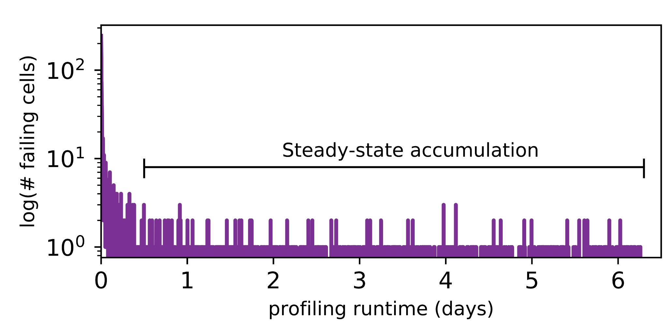
Long-term Continuous Profiling
Representative chip from Vendor B, 2048ms, 45°C
# New Failing Cells
Error correction codes (ECC)
and online profiling are necessary
to manage new failing cells
Time (days)
New failing cells continue to appear over time
Attributed to variable retention time (VRT)
The set of failing cells changes over time
Notes:
Here is some data we collected from a representative chip at a fixed refresh interval of 2048ms.
We show the number of new failing cells discovered by continuously profiling over 6 days.
[CLICK]
We see that new failing cells continue to appear over time.
We attribute these to variable retention time effects, which mean that cells can randomly change retention times at any point.
[CLICK]
This shows that the set of failing cells we find at 2048ms changes over time
[CLICK]
This means that error correction codes and online profiling are necessary to manage new failing cells that continue to appear
[END]

Slide 60
Single-cell Failure Probability (Cartoon)
idealized cell
(retention time = 3s)
actual cell
N(μ, σ) | μ = 3s
Notes:
In another study, we analyzed the failure probability of individual cells.
Here we show the probability of read failure for a single cell over different refresh intervals
We show an idealized cell, with never fails below 3.5 seconds, but always fails above 3.5s
We can say that this cell has a retention time of 3.5s.
[CLICK]
However, we find that real cells look more like the blue cartoon, which follows a normal distribution with a mean at 3.5s.
Note that even below 3.5s, there is a nonzero probability of the cell failing.
[END]

Slide 61
Single-cell Failure Probability (Real)
operate here
profile here
easy
Any cell is more likely to fail
at a longer refresh interval
OR a higher temperature
to find
failed 9 times out of 16 trials
hard
false
to find
positives
Notes:
TEMPERATURE TEMPERATURE TEMPERATURE TEMPERATURE TEMPERATURE TEMPERATURE TEMPERATURE
Here we show real data from a real chip, [CLICK] which we collected by testing how often the cell failed out of 16 trials for different refresh intervals.
[CLICK]
We now show 8 different cells from the same chip.
[CLICK]
Suppose we are interested in operating at a refresh interval of 1.7 seconds.
[CLICK]
We will find 6 cells with a non-negligible probability of failing
[CLICK]
However, the bottom two cells will be hard to find since they have a low probability of failure at this refresh interval
[CLICK]
Instead, if we profile at an increased refresh interval, [CLICK] the same cells will be much easier to find since they will have a high probability of failure.
[CLICK]
However, we will also identify some additional cells as failing, which can end up being false positives.
[CLICK]
We repeat the same analysis for temperature variation and find that cells behave similarly. We show details of this analysis in the paper.
[CLICK]
The takeaway here is that any given cell is more likely to fail at a longer refresh interval or a higher temperature.
[END]

Slide 62
Temperature Relationship
Well-fitting exponential relationship:
E.g., 10°C ~ 10x more failures

Slide 63
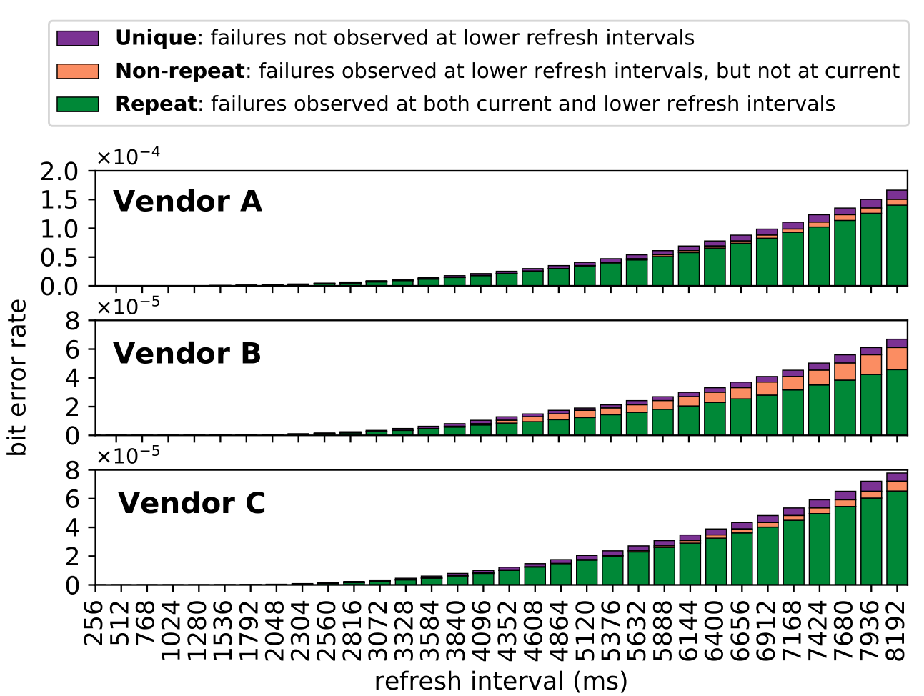
Retention Failures @ 45°C

Slide 64
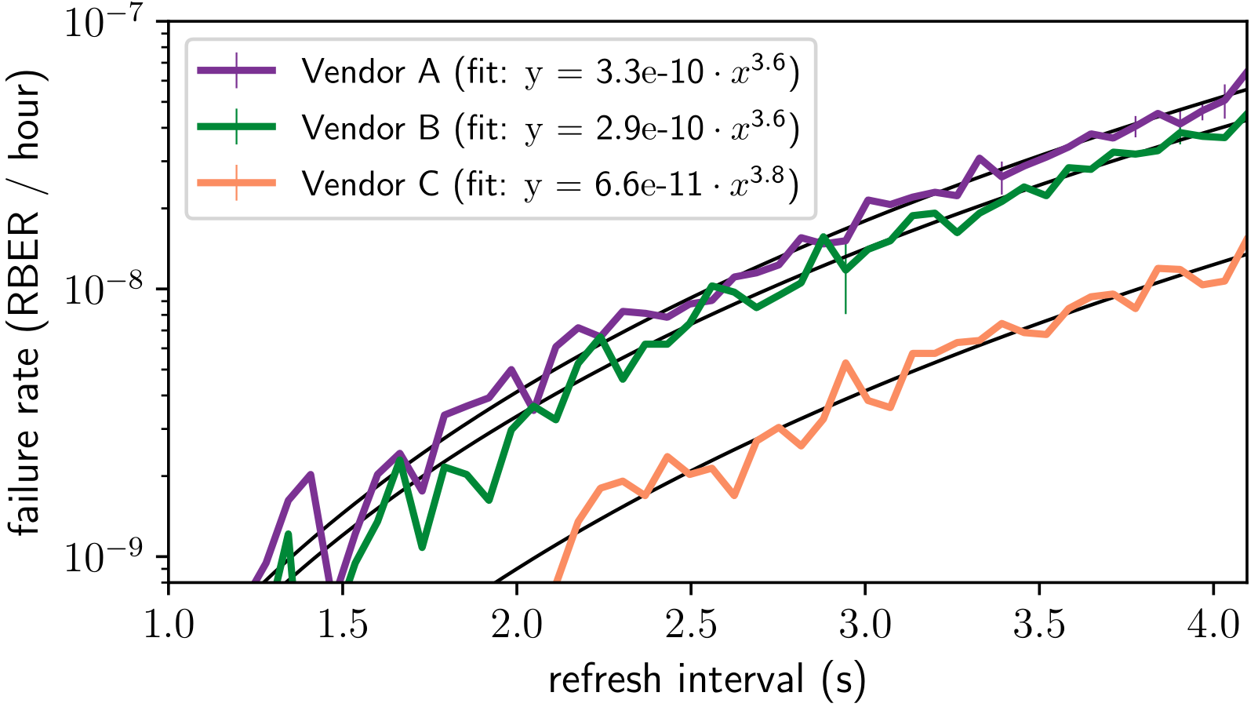
VRT Failure Accumulation Rate
Notes:
BACKUP!!!

Slide 65
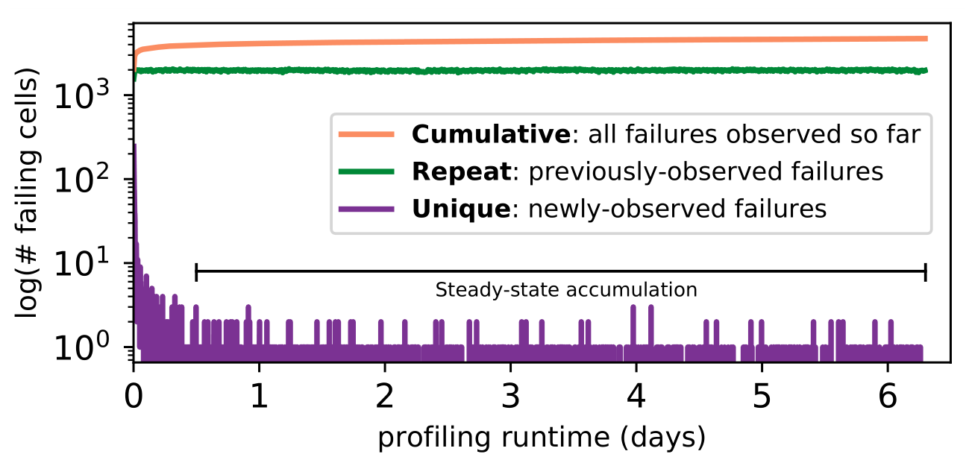
800 Rounds of Profiling @ 2048ms, 45°C

Slide 66
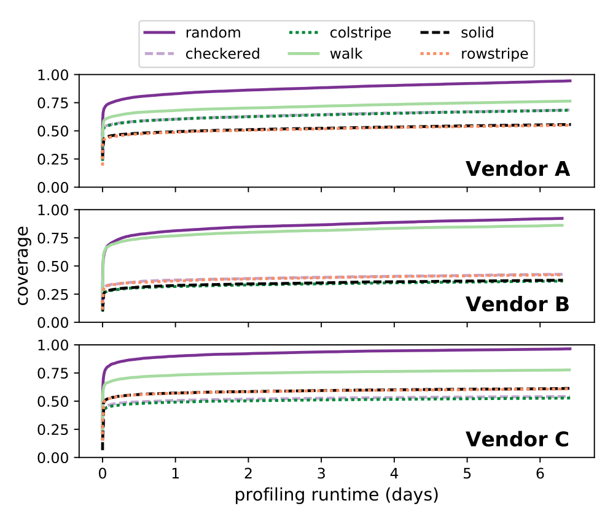
800 Rounds of Profiling @ 2048ms, 45°C

Slide 67
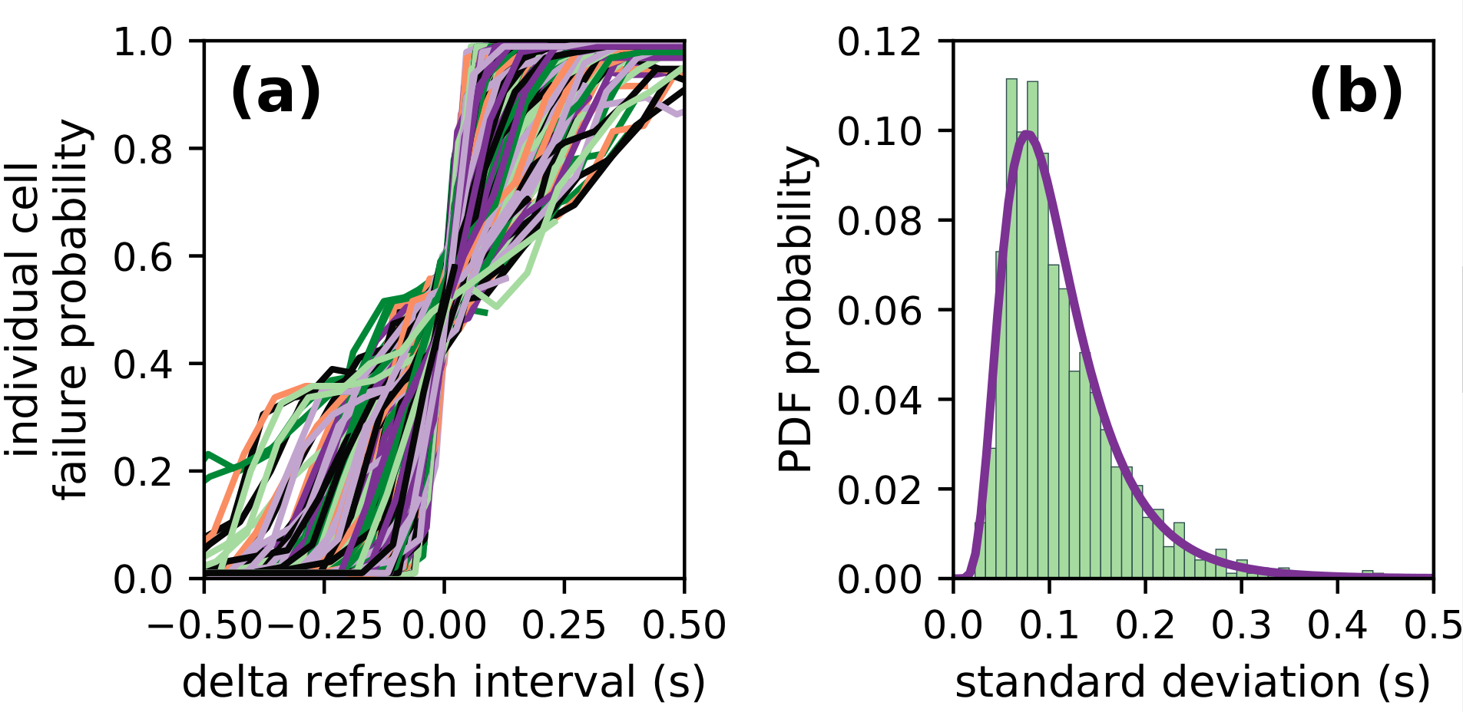
Individual Cell Failure Probabilities
Single representative chip of Vendor B at 40° C
Refresh intervals ranging from 64ms to 4096ms

Slide 68
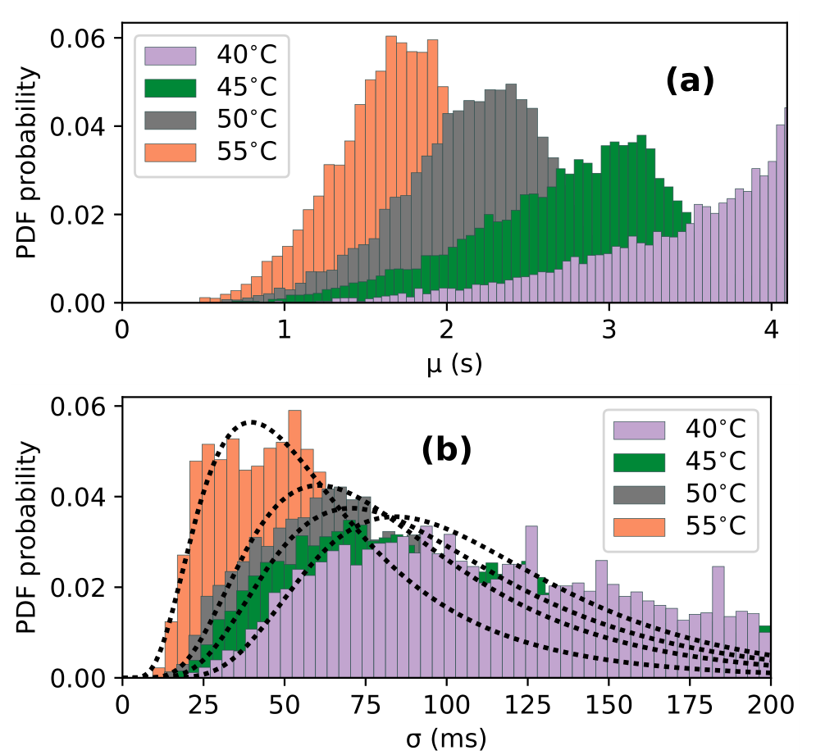
Individual Cell Failure Distributions

Slide 69
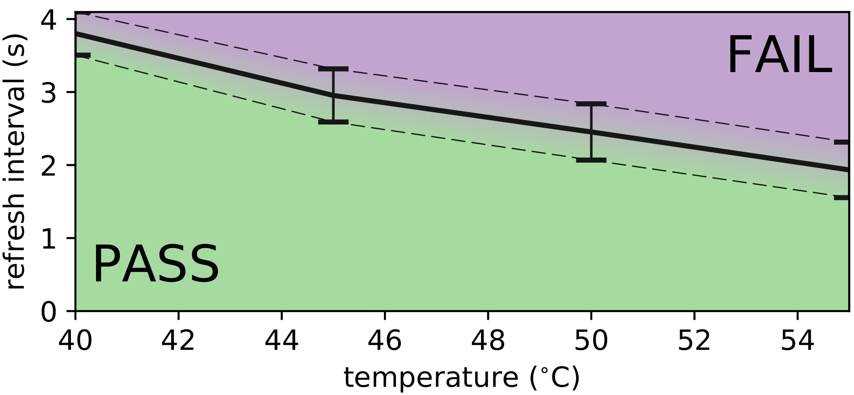
Single-cell Failures With Temperature
Single representative chip of Vendor B
{mean, std} for cells between 64ms and 4096ms

